Slide 1
Taiwanese Speech Recognition
314581029 盧楷勛

Slide 2
Platform
13th Gen Intel(R) Core(TM) i7-13700
NVIDIA GeForce RTX 4070 SUPER (12GB VRAM)

Slide 3
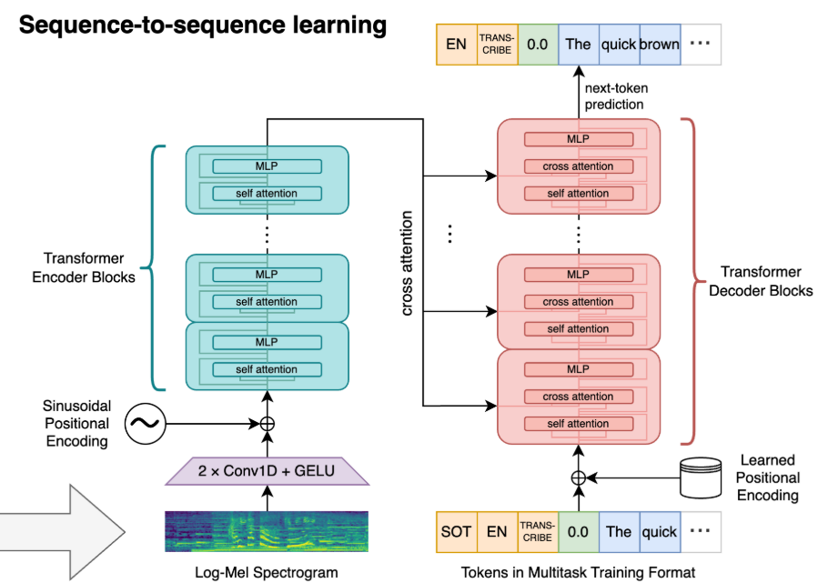
Model info
whisper_small
whisper_large_v3_turbo_4bit_QLoRA
whisper_large_v3_turbo (final)
Precision: FP16
subword-level (BPE)
Tuned from pre-trained model

Slide 4
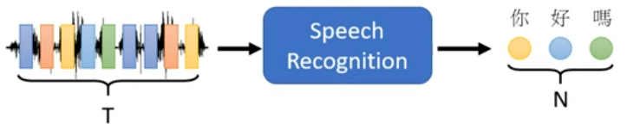
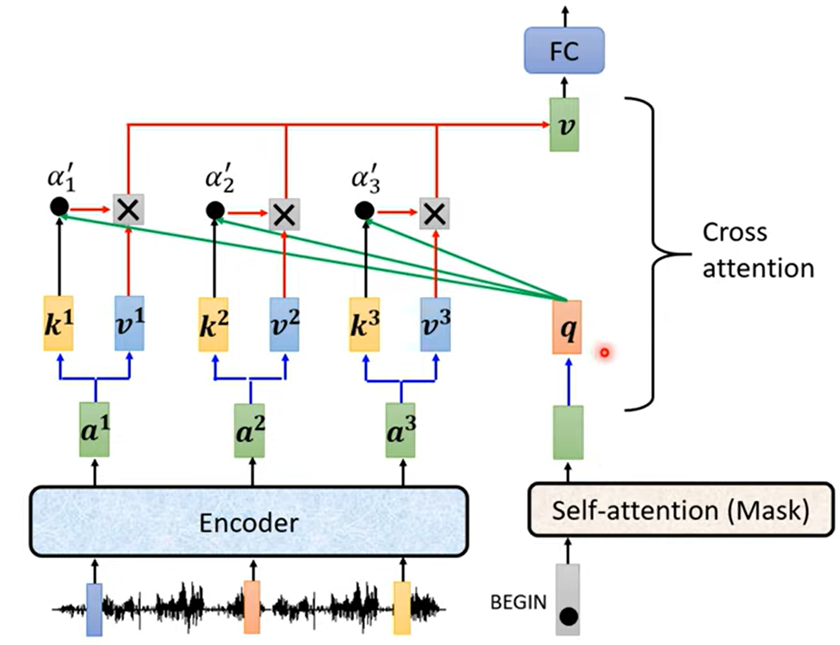
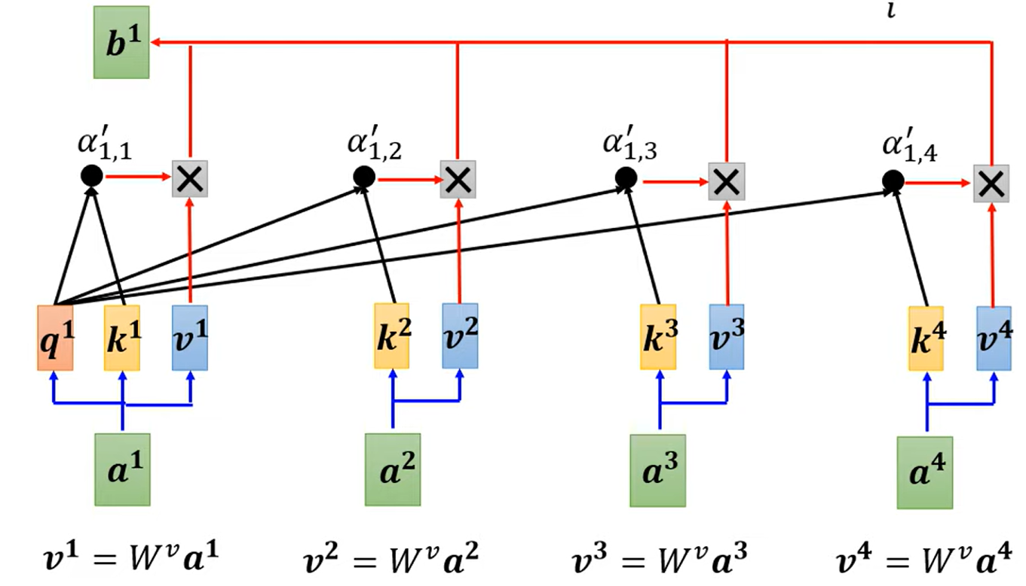
What is Whisper? Brief explanation of Encoder-Decoder Transformer architecture
A sequence to sequence model where output length is determined by model (Autoregressive Decoder: generate EOS itself)
And has self attention on encoder, masked self-attention & cross attention on decoder side.

Slide 5
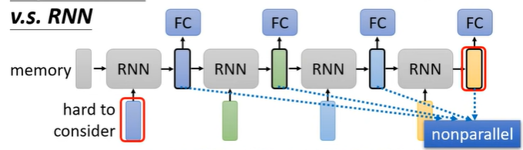
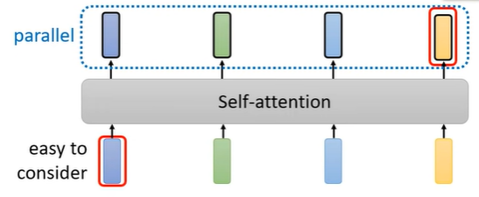
Whisper vs. RNN major difference
Share information in memory (hidden state)
Built in sequence order
Must compute output in serial
Long-range degrade (Even with LSTM)
Share information with attention
Requires positional encoding
Can compute output vector in parallel (encoder)
Attention over entire sequence

Slide 6
Evaluation
Mean Levenshtein Distance
Word Error Rate

Slide 7
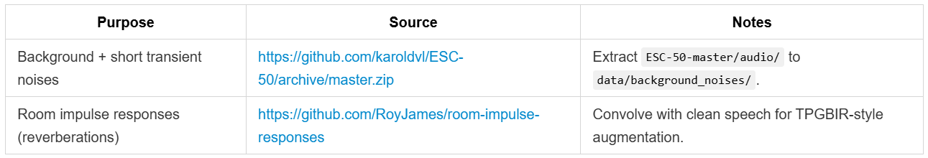
Data source
Train (x3012)
Dictionary-word (x21788)
Dictionary-sentence (x17697)

Slide 8
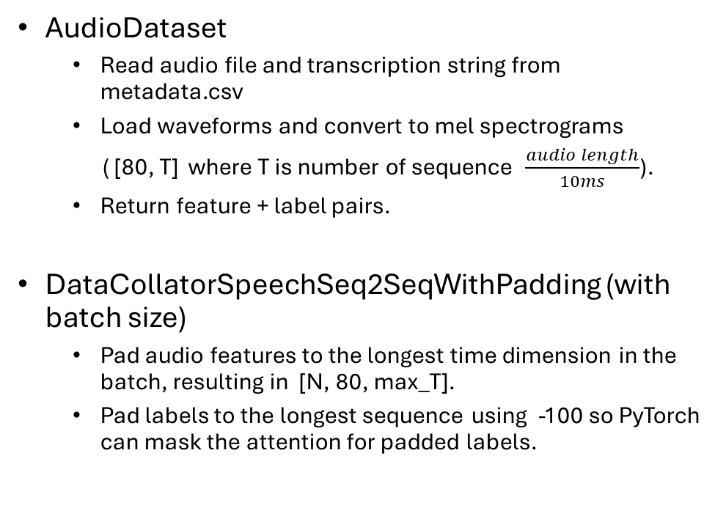
Data preprocessing AudioDataset & DataCollatorSpeechSeq2SeqWithPadding
AudioDataset
Read audio file and transcription string from metadata.csv
Load waveforms and convert to mel spectrograms
( [80, T] where T is number of sequence $\frac{audio length}{10ms}$).
Return feature + label pairs.
DataCollatorSpeechSeq2SeqWithPadding (with batch size)
Pad audio features to the longest time dimension in the batch, resulting in [N, 80, max_T].
Pad labels to the longest sequence using -100 so PyTorch can mask the attention for padded labels.
Sample 1: input_features [80, 523], labels [15]
Sample 2: input_features [80, 1842], labels [28]
Sample 3: input_features [80, 891], labels [22]
…
batch 1 (N sameples):
input_features [80, 1842], labels [28]
input_features [80, 1842], labels [28]
…
batch 2 (N sameples):
input_features [80, 430], labels [14]
input_features [80, 430], labels [14]
…
…

Slide 9
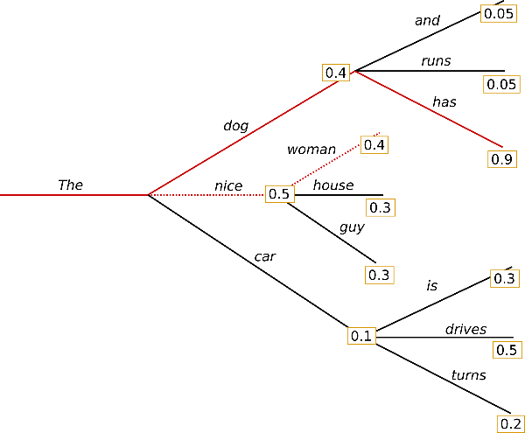
Configurations Training and Inferencing configuration
Train
Optimizer: AdamW
Weight Decay: 0.01
Learning Rate: 1e-5 (linear scheduler)
Eval: Every 500 steps
Batch Size: 4 per device (gradient accumulation=16)
Max Gradient Norm: 1.0
Epochs: 5
Audio: 16kHz sampling rate, 80-channel Mel spectrogram
Max Audio Length: 30 seconds
Train/Val Split: 90% / 10%
Inference
Beam Search: 3 beams
$$Total step=epoches∗\frac{dataset size}{per device train batch size ∗ num devices ∗ gradient accumulation steps}$$

Slide 10
Training Attempts

Slide 11
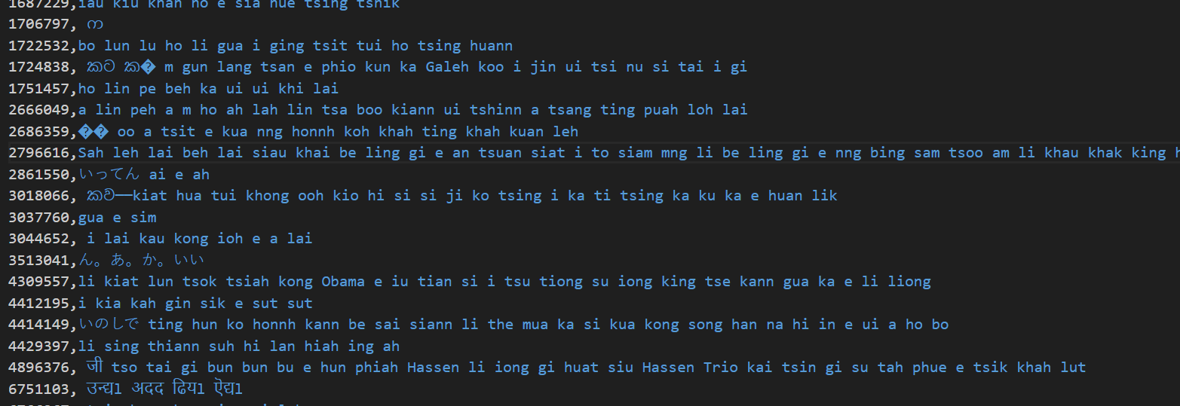
Attempt #1 x1 augmentation without noise + impulse response
Some none alphabet character was generated

Slide 12
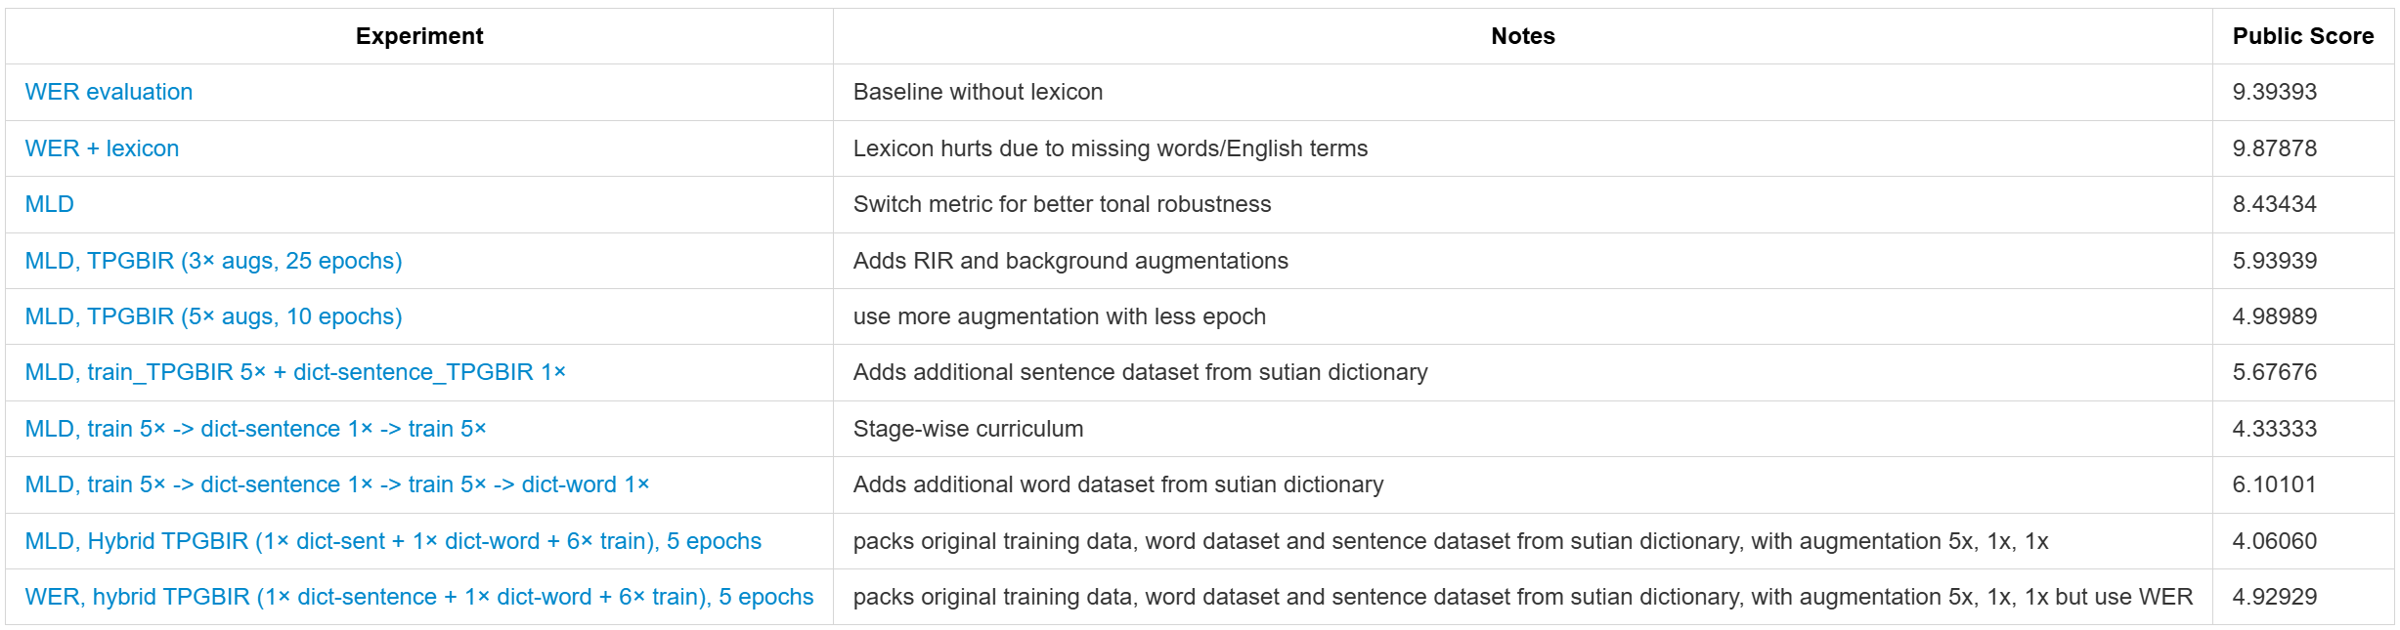
Training experiment results

Slide 13
Attempt #2 use Lexion.txt to fix words
Training / Test data contains English speaking, e.g. VR, GPU, Obama, Isarel...
word level tokenizer for Taiwanese based on lexion is impossible on this dataset
character level tokenizer is feasible but requires additional work

Slide 14
Training experiment results

Slide 15
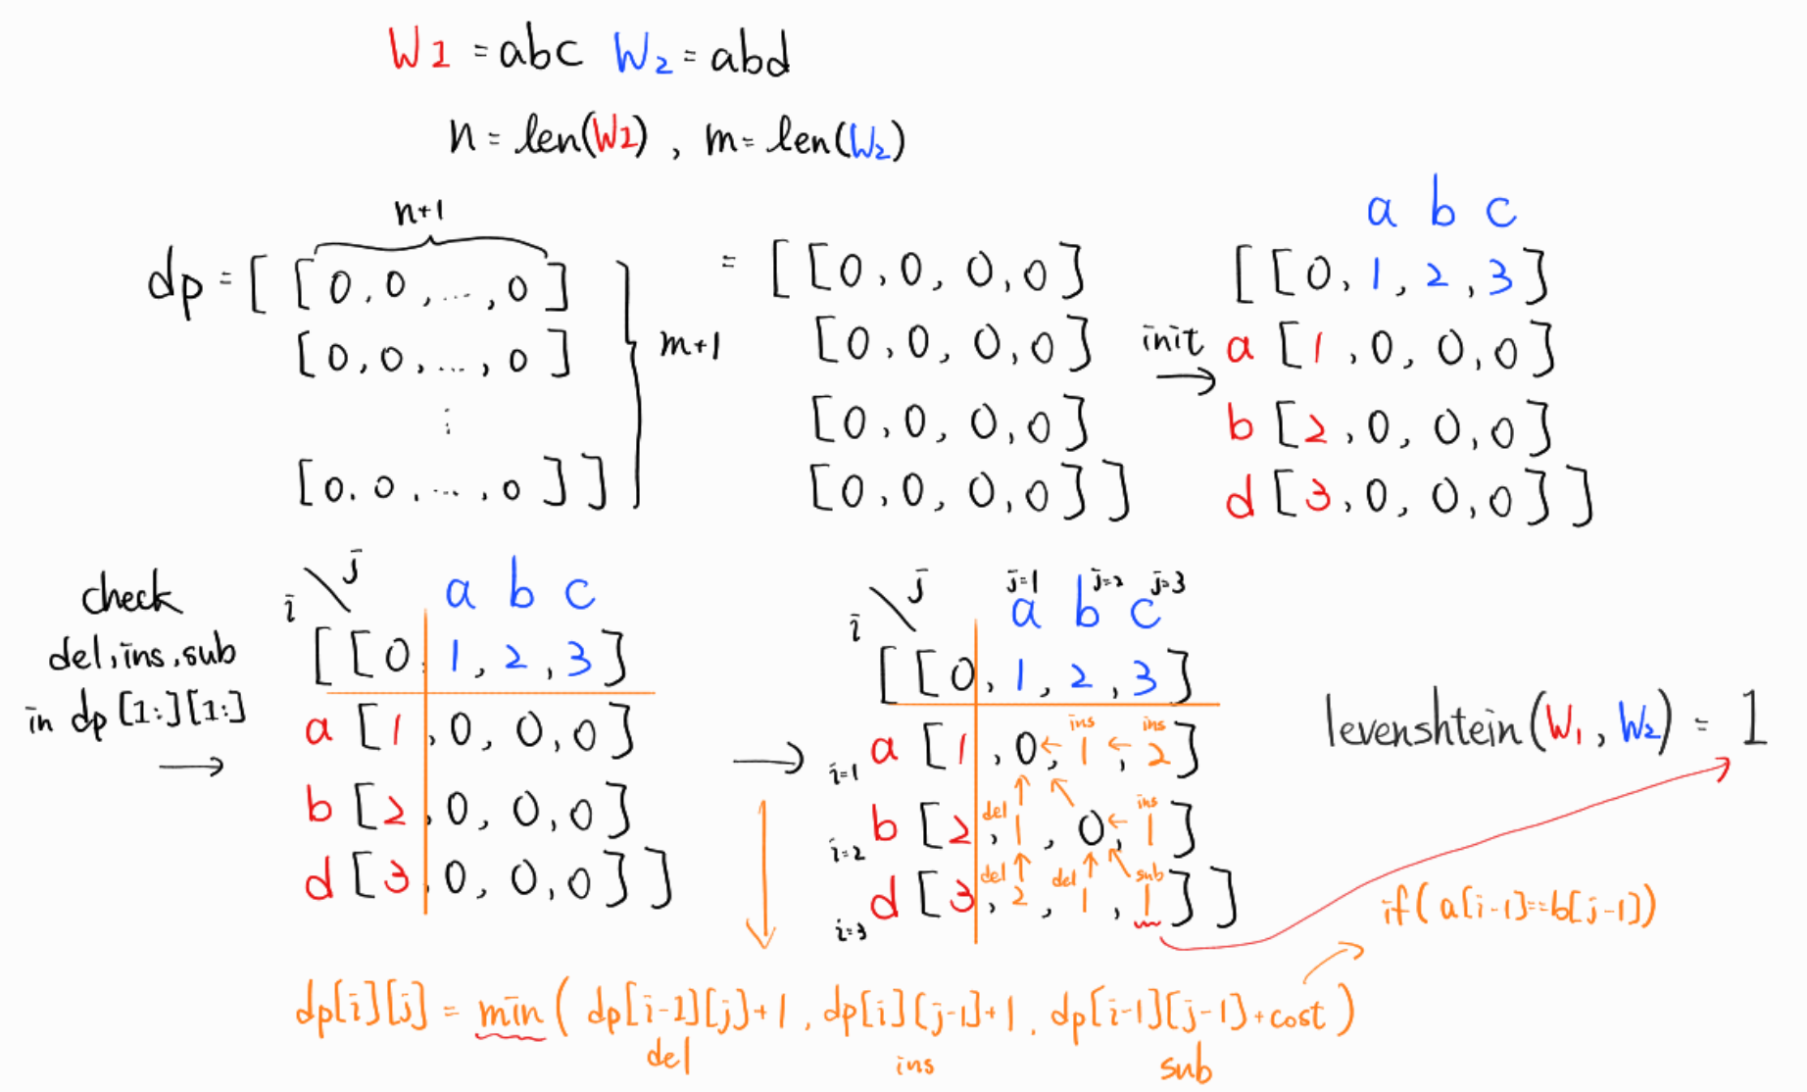
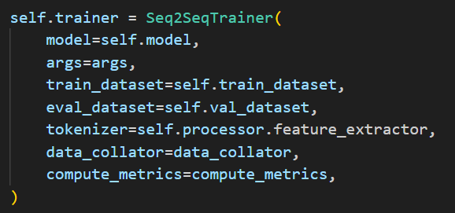
Attempt #3 use Mean Levenshtein Distance as evaluation function

Slide 16
Training experiment results

Slide 17
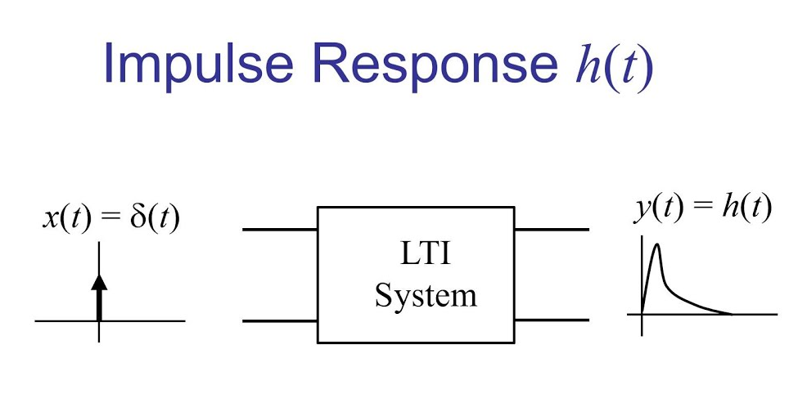
Attempt #4 x3 augmentation with noise + room impulse response

Slide 18
Training experiment results

Slide 19

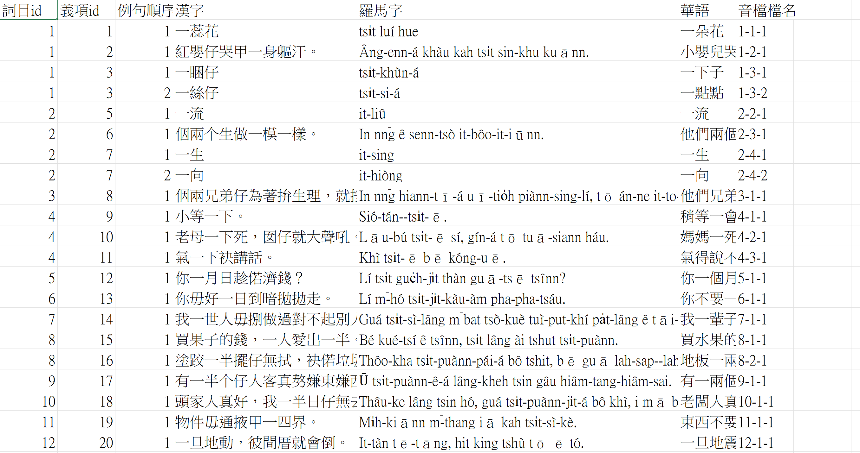
Attempt #5 more data
https://sutian.moe.edu.tw/zh-hant/siongkuantsuguan/
Dictionary-word (x21788)
Dictionary-sentence (x17697)

Slide 20
Training experiment results

Slide 21
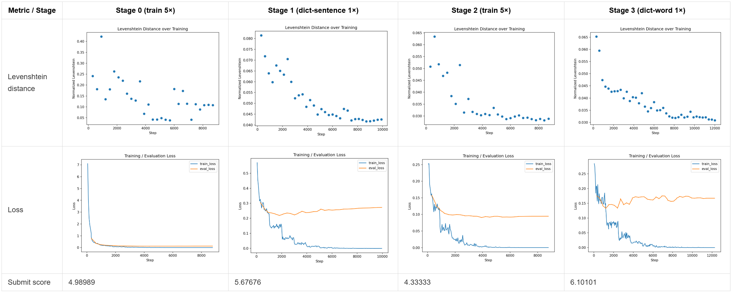
Attempt #6 Stage-wise auto finetune pipeline
Overfitting on dictionary datasets

Slide 22
Training experiment results

Slide 23
Attempt #7 Hybrid dataset with balanced augmentation
background/shortnoise (x2000)
room impulse response (x3602)
GaussianSNR
TimeStretch
PitchShift
Train (x3012) x6 + Dictionary-word (x21788) x1 + Dictionary-sentence (x17697) x1
= 57557 audio files (about 25GB)

Slide 24
Training experiment results

Slide 25
Attempt #8 Try use WER again

Slide 26
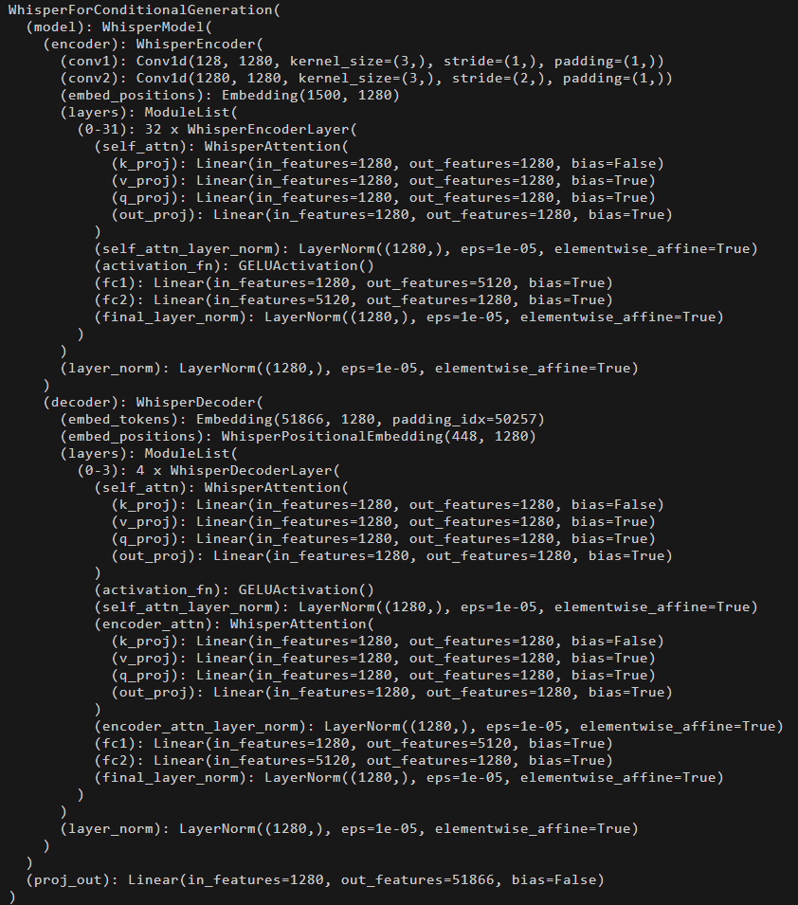
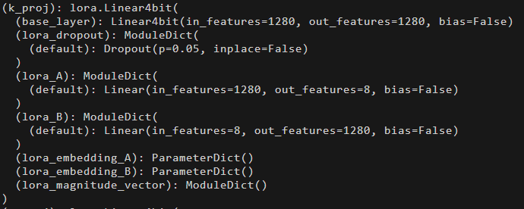
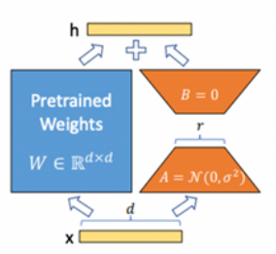
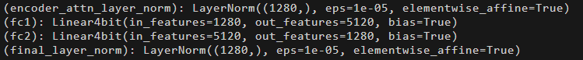

Attempt #9 Load larger model with LoRA and quantization
Layer | Parameters
Full 1280×1280 | 1,638,400
LoRA (rank 8) | 1280×8 + 8×1280 = 20,480
h = W · x (FP16)
h = (W_4bit + BA) · x (NF4)
Where A has shape (1280,8)
And B has shape (8, 1280)

Slide 27
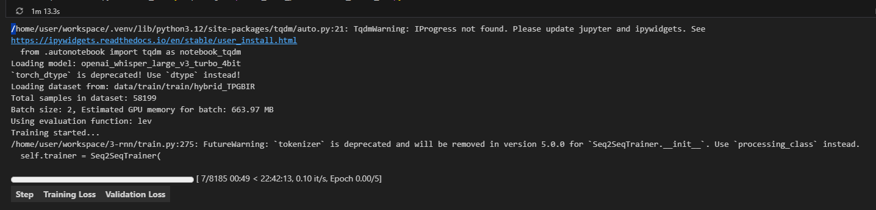
Training experiment

Slide 28
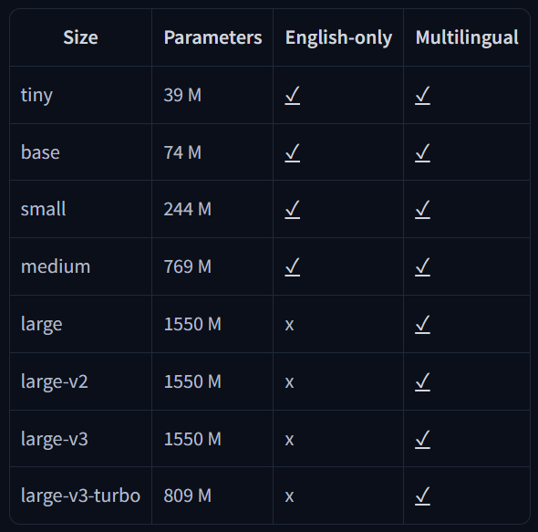
Attempt #10 (Final attempt) Use larger model with FP16
Special thanks to my friend
for lending me 4090

Slide 29
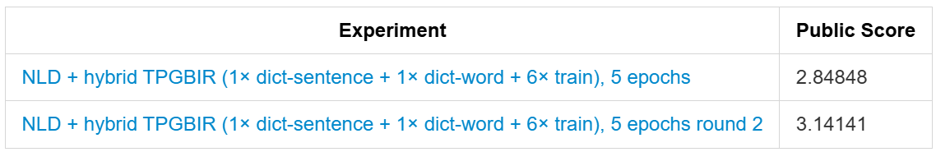
Training experiment results

Slide 30
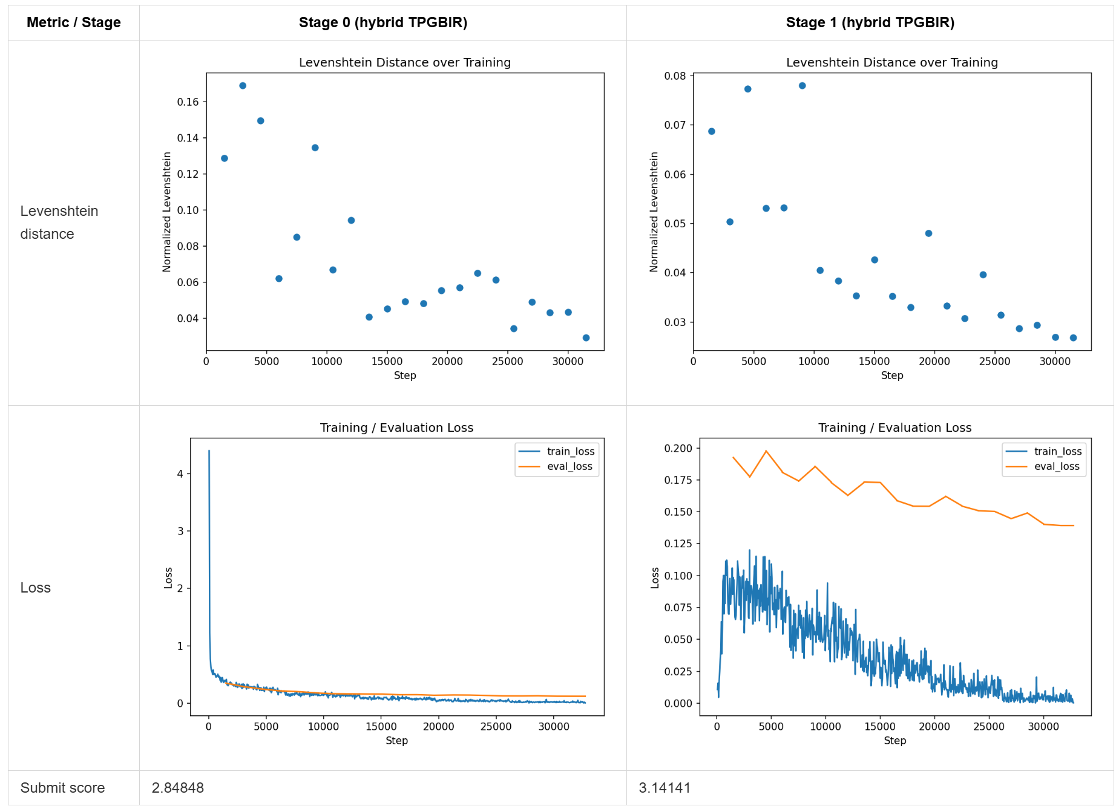
Training experiment results
Overfitting on dictionary datasets

Slide 31
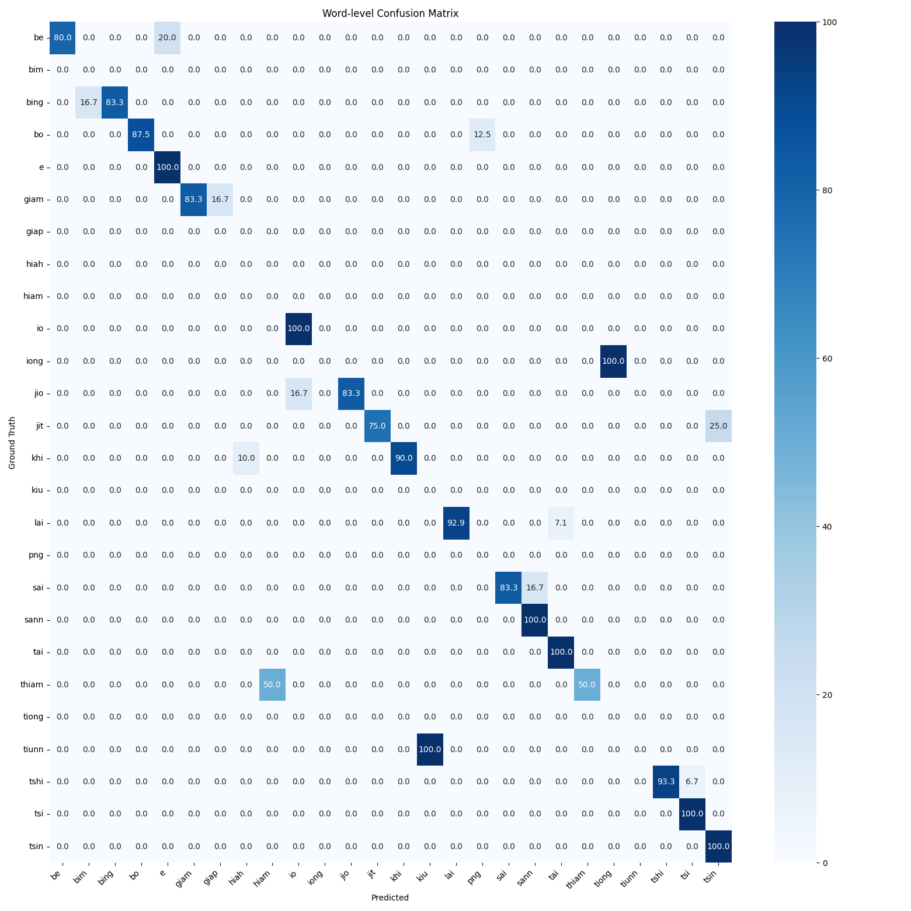
Confusion metrics
thiam -> hiam (50%)
jio -> io (25%)
giam -> giap (16.7%)
bing -> bim (16.7%)
tshi -> tsi (6.7%)
…

Slide 33
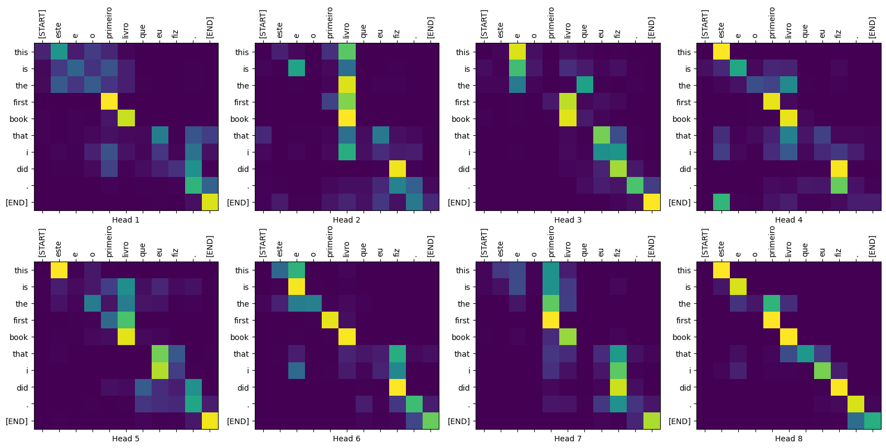
Attention Heatmap Visualization (demonstration only)

Slide 34
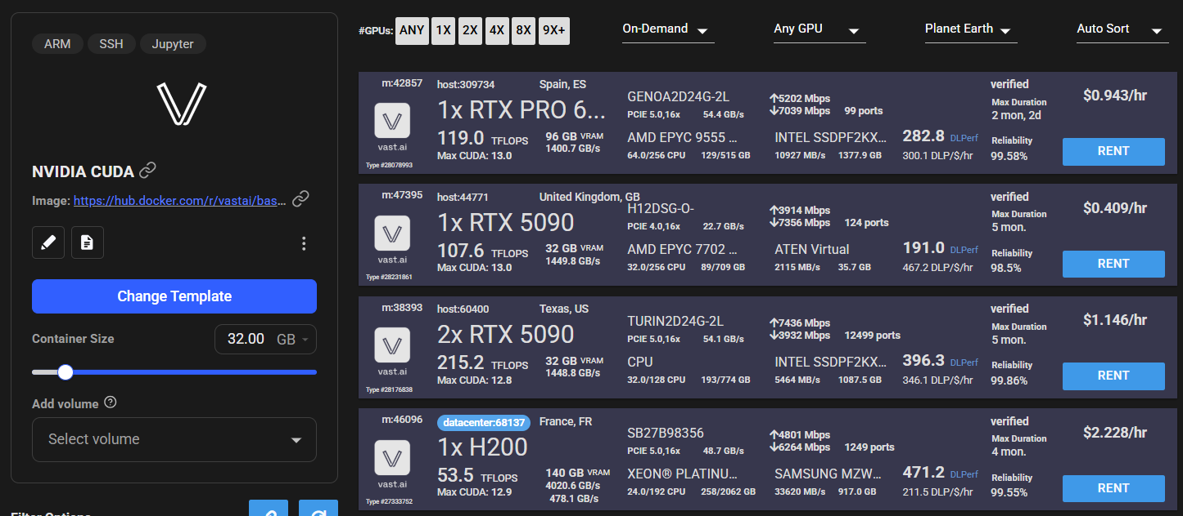
Experience share: vast.ai

Slide 35
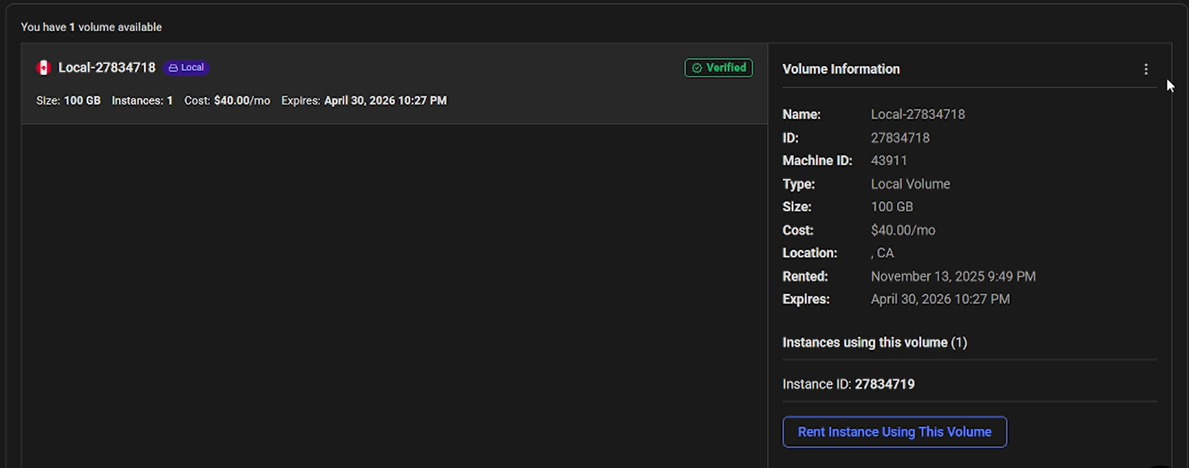
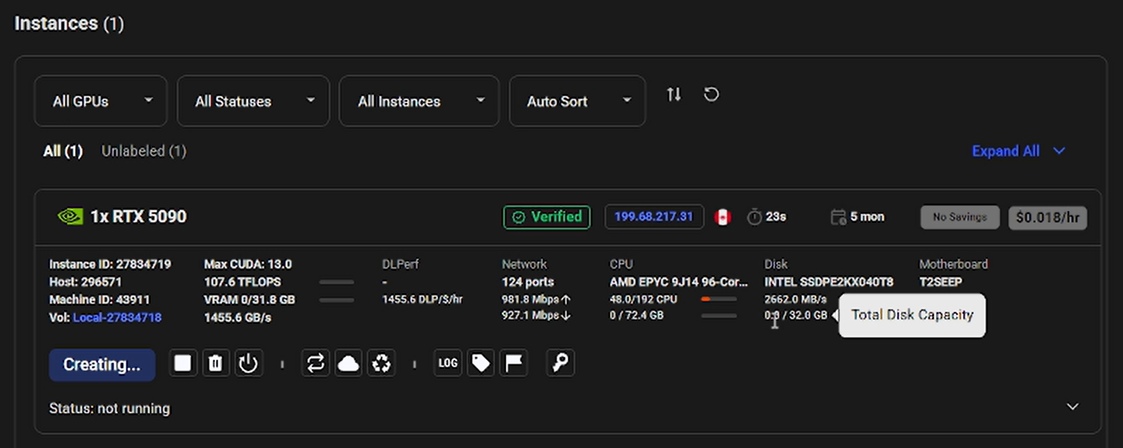
Experience share: vast.ai

Slide 36

Thank you
NYCU-IAII-ML2025 — Taiwanese Speech Recognition

